Slide 1
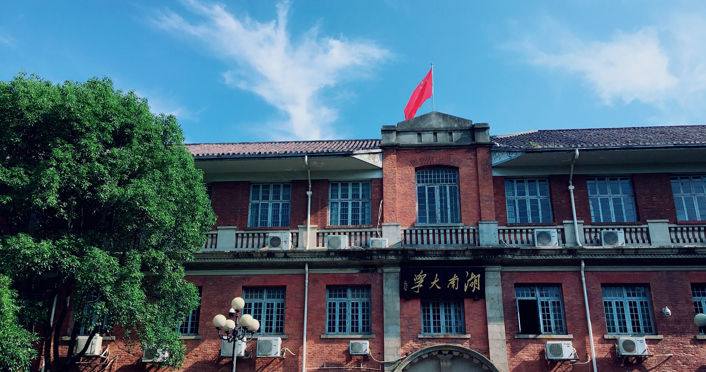

博學 · 睿思 · 勤勉 · 致知
HNU
Ten Lessons From Three Generations Shaped Google’s TPUv4i
reporter：金洁茜 S211000820

Slide 2
contents
01 Brief information of the paper
02 TPUv1 & TPUv2 & tpuv3
03 Ten Lessons From Three Generations
04 TPUv4i

Slide 3
Brief information of the paper
1
PART

Slide 4
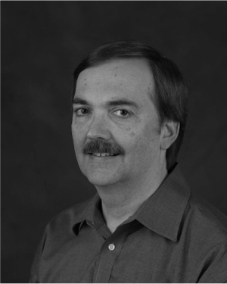
01 Brief information of the paper
2021 ACM/IEEE 48th Annual International Symposium on Computer Architecture (ISCA)
Author：Norman P . Jouppi
Norman P. Jouppi is a Distinguished Hardware Engineer at Google. He was the tech lead for Google's first- and second-generation TPUs. He is known for his innovations in computer memory systems, was the principal architect and lead designer of several microprocessors, contributed to the architecture and design of graphics accelerators, and extensively researched telepresence.
Contact him at jouppi@google.com.

Slide 5
01 Brief information of the paper
TPU？——Tensor Processing Unit
WHY?——Computing Power...

Slide 6
TPUv1 & TPUv2 & tpuv3
2
PART

Slide 7
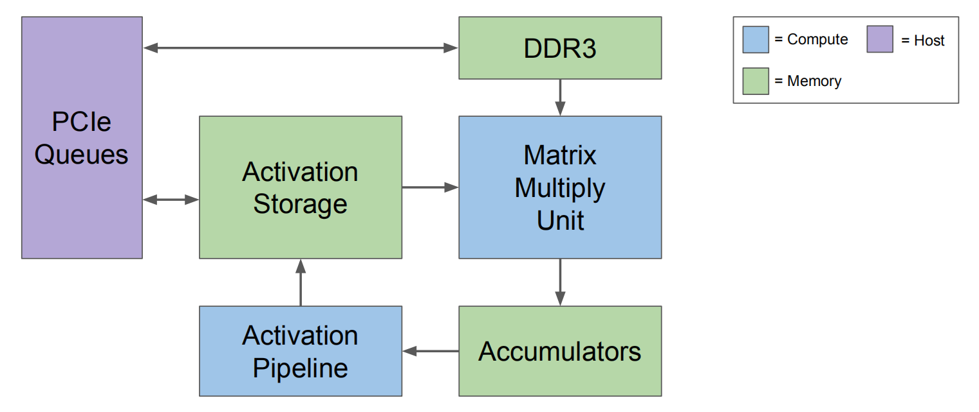
02 TPUv1 & TPUv2 & tpuv3
TPUv1
TPUv1—— Google’s first DNN DSA, handles inference (also called serving).

Slide 8
02 TPUv1 & TPUv2 & tpuv3
TPUv1
TPUv1 connects to the host CPU over PCIe for exchanging model inputs and outputs at even lower bandwidth.
The host CPU also sends TPUv1 instructions over PCIe.
Compared to contemporary GPUs and CPUs, its performance/TDP (perf/Watt) on production workloads was 30-80X higher.

Slide 9
02 TPUv1 & TPUv2 & tpuv3
TPUv2
TPUv2 addresses the harder task of training：
Harder Parallelization
More Computation
More Memory
More Programmablility
Wider Operands

Slide 10
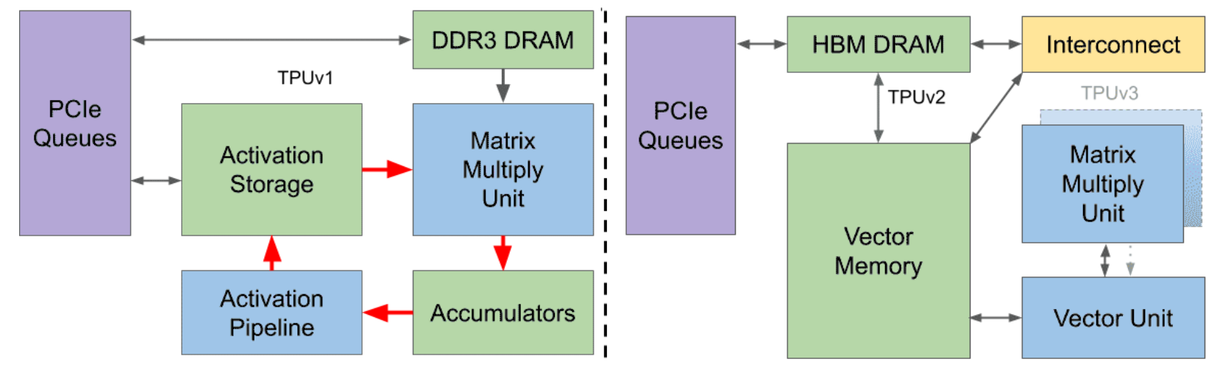
02 TPUv1 & TPUv2 & tpuv3
TPUv2
The TPUv1 block diagram can be transformed into TPUv2 via a sequence of changes, showing the more general needs of training over inference.

Slide 11
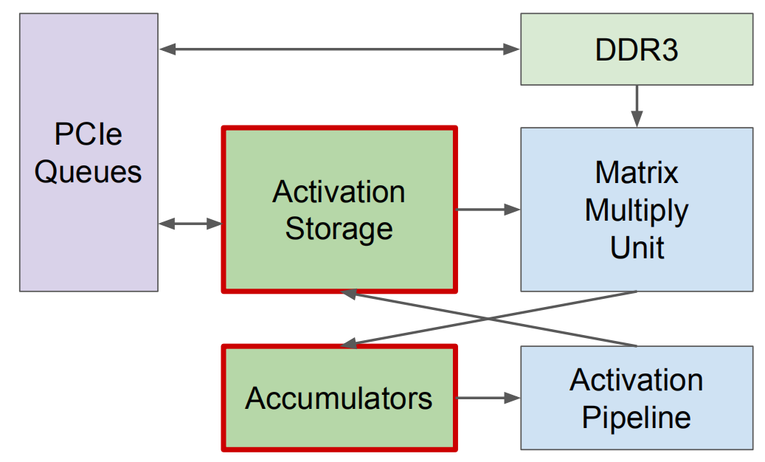
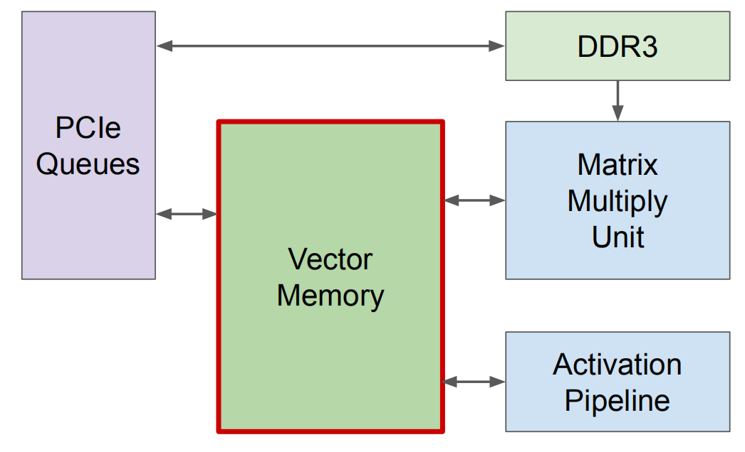
02 TPUv1 & TPUv2 & tpuv3
TPUv2——Change 1
Single vector memory instead of buffers between fixed function units.

Slide 12
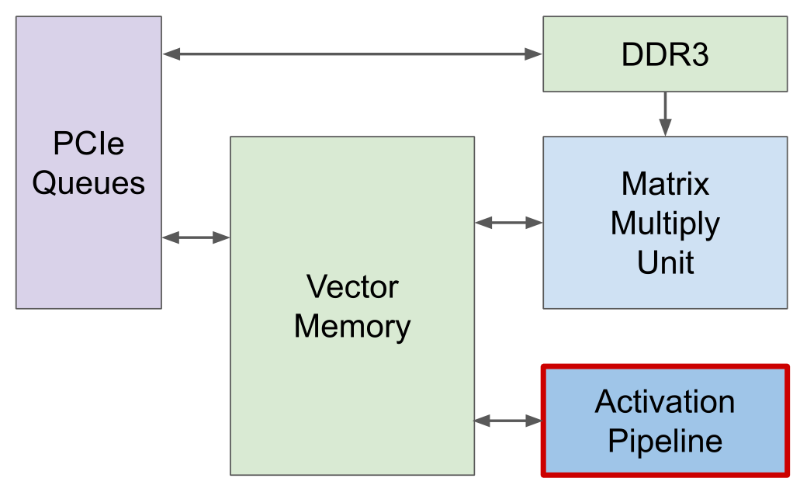
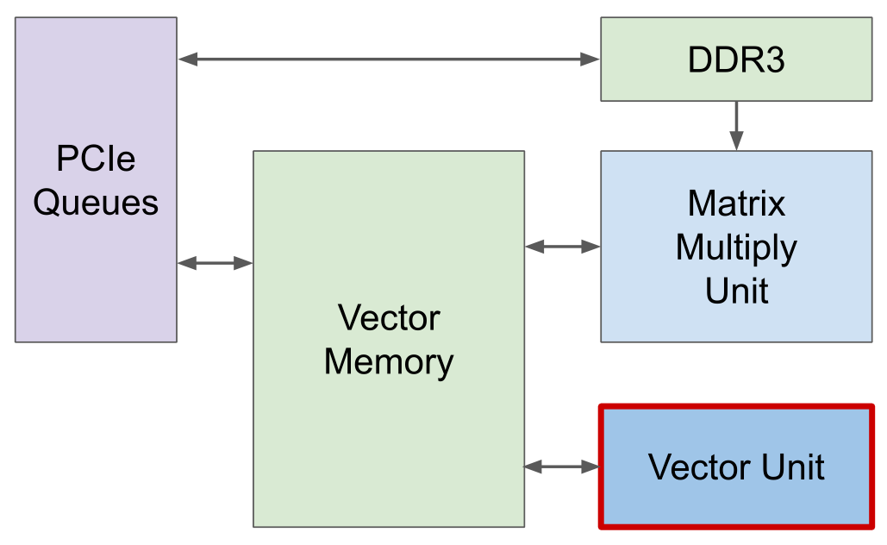
02 TPUv1 & TPUv2 & tpuv3
TPUv2——Change 2
General purpose vector unit instead of a fixed function activation pipeline.

Slide 13
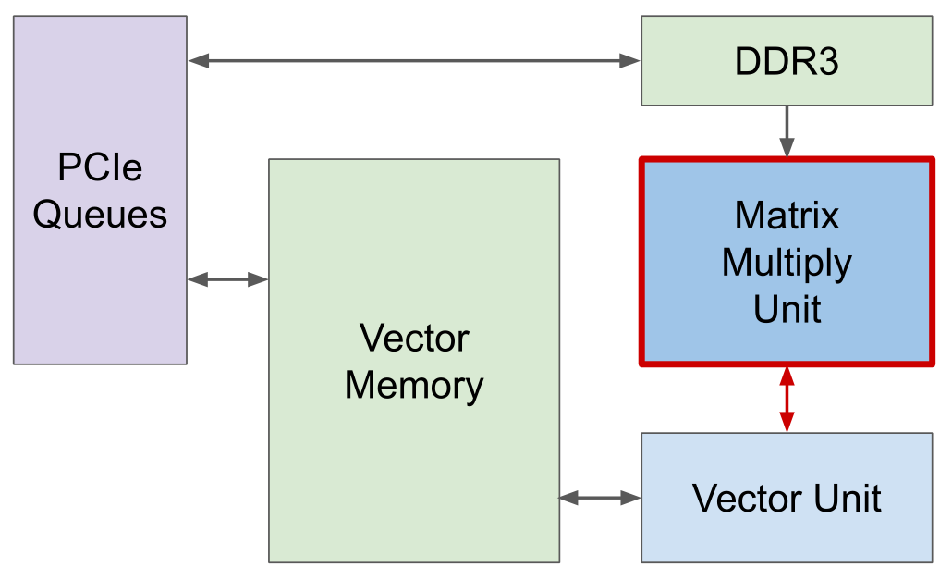
02 TPUv1 & TPUv2 & tpuv3
TPUv2——Change 3
Connect matrix multiply unit as an offload for the vector unit.

Slide 14
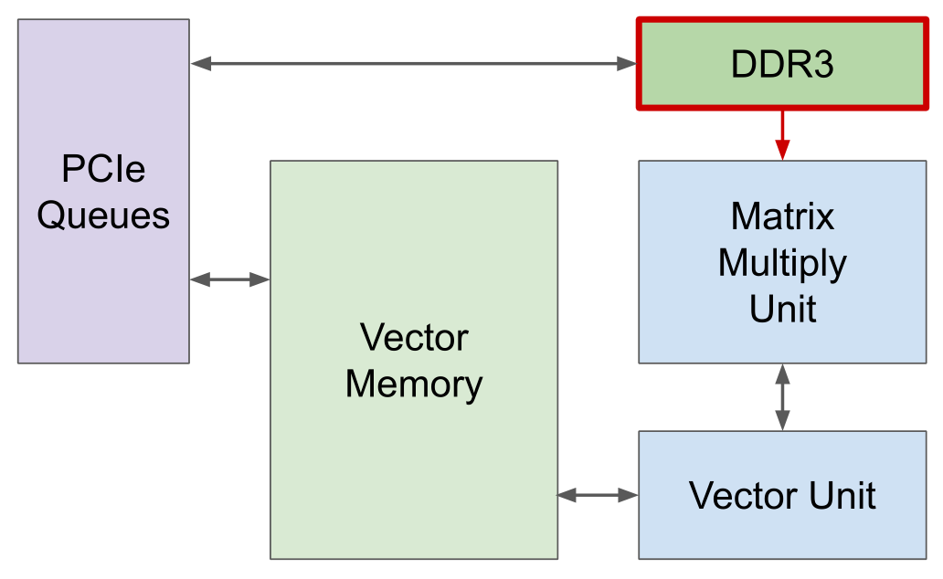
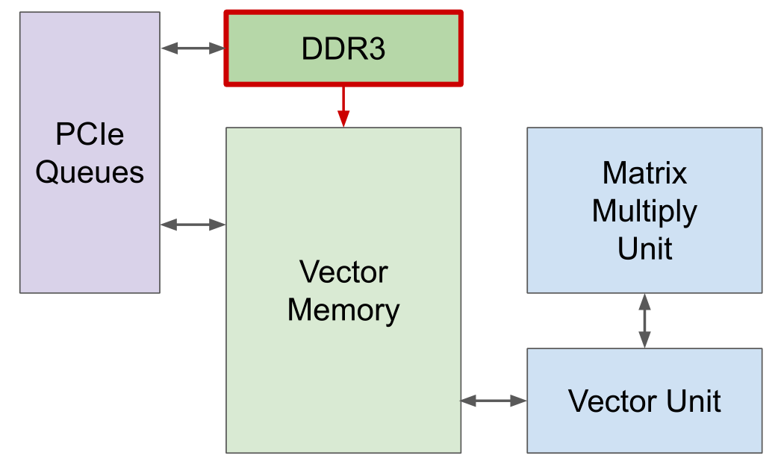
02 TPUv1 & TPUv2 & tpuv3
TPUv2——Change 4
Connect DRAM into the memory system instead of directly into the matrix multiply unit.

Slide 15
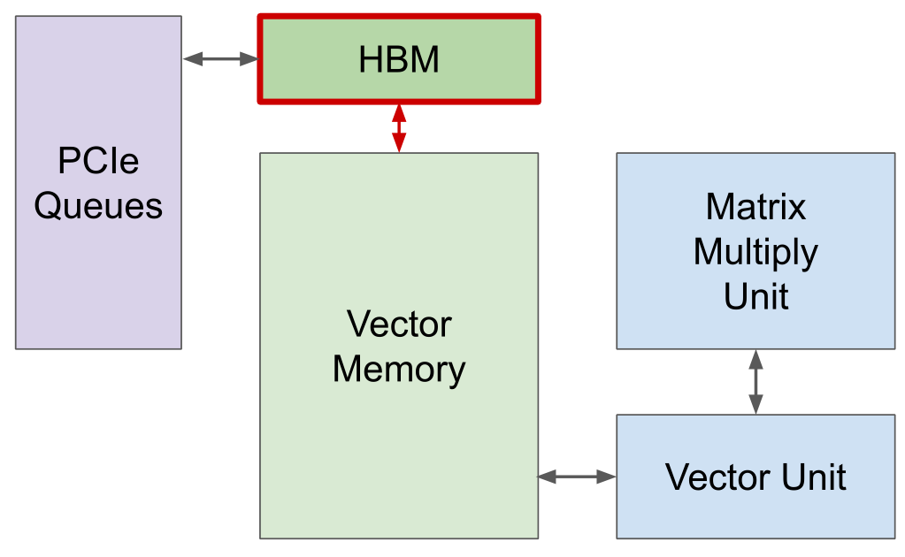
02 TPUv1 & TPUv2 & tpuv3
TPUv2——Change 5
Move to HBM for bandwidth

Slide 16
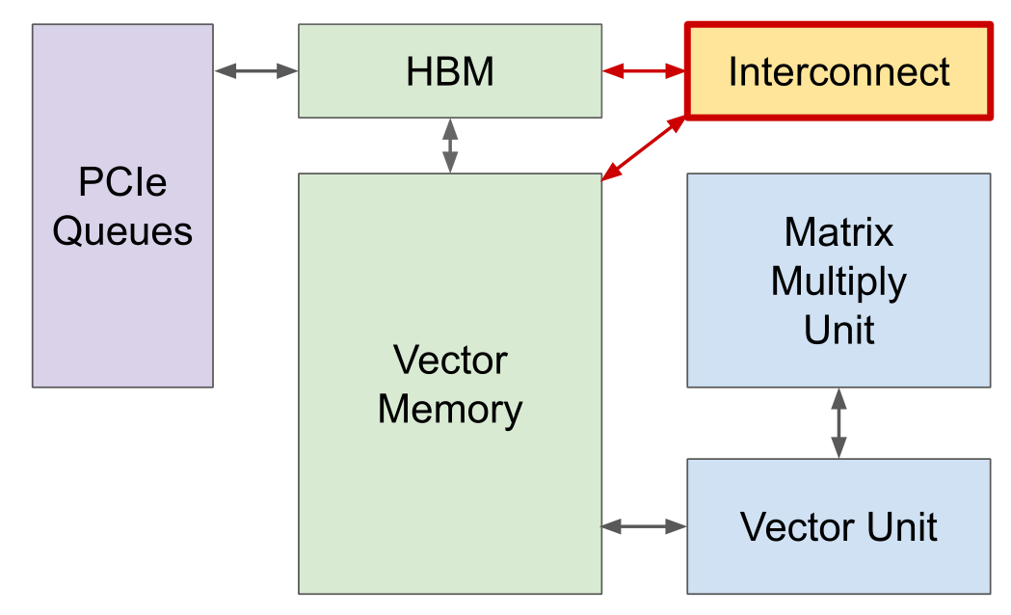
02 TPUv1 & TPUv2 & tpuv3
TPUv2——Change 6
Add interconnect for high-bandwidth scaling

Slide 17
02 TPUv1 & TPUv2 & tpuv3
TPUv3
TPUv3 is a mild redesign of TPUv2 in the same technology that has 2X the number of MXUs and HBM capacity and increases the clock rate, memory bandwidth, and ICI bandwidth by 1.3X.
A TPUv3 supercomputer also scales up to 1024 chips.
TPUv3 matches the contemporary Volta GPU when both use 16-bit floating point (bfloat16 vs IEEE fp16).

Slide 18
Ten Lessons From Three Generations
3
PART

Slide 19
03 Ten Lessons From Three Generations
The first three lessons apply to any DSA, and perhaps even to GPUs and CPUs.
① Logic, wires, SRAM, & DRAM improve unequally
② Leverage prior compiler optimizations
③ Design for performance per TCO vs per CapEx
Domain Specific Architecture (DSA)

Slide 20
03 Ten Lessons From Three Generations
① Logic, wires, SRAM, & DRAM improve unequally
Logic improves much faster than wires and SRAM, so logic is relatively “free.” HBM is more energy-efficient than GDDR6 or DDR DRAM. HBM also has the lowest cost per GB/s of bandwidth.
② Leverage prior compiler optimizations
Architects wish for great compilers to be developed on simulators, yet much of the progress occur safter hardware is available since compiler writers can measure actual time taken by code. Thus, reaching an architecture’s full potential quickly is much easier if it can leverage prior compiler optimizations rather than starting from scratch.

Slide 21
03 Ten Lessons From Three Generations
③ Design for performance per TCO vs per CapEx
A DSA should aim for good Perf/TCO over its full lifetime, and not only at its birth.
Two TCO factors come directly from power: the costs of electricity used and of provisioning power—power distribution and cooling

Slide 22
03 Ten Lessons From Three Generations
performance per TCO vs Per CapEx
CapEx: Capital Expense is the price of an item .
OpEx: Operation Expense is the cost of operation. including electricity consumed and power provisioning(power distribution and cooling).
TCO：Total cost of ownership
Standard accounting amortizes computer CapEx over 3-5 years, so for 3 years
​ TCO = CapEx + 3 ✕ OpEx.
Google and most companies care more about performance/TCO of production apps (perf/TCO) than raw performance or performance/CapEx (perf/CapEx) of benchmarks.

Slide 23
03 Ten Lessons From Three Generations
The next 3 lessons are focused on DNN DSAs.
④ Support Backwards ML Compatibility
⑤ Inference DSAs need air cooling for global scale
⑥ Some inference apps need floating point arithmetic

Slide 24
03 Ten Lessons From Three Generations
④ Support Backwards ML Compatibility
Any new inference TPU would at least need to offer the same numerics to get the same results and the same exception behavior: bfloat16 and IEEE fp32 would be required. If a new TPU doesn't support the same operations or numeric types, then the compiler can’t give a backwards ML compatibility guarantee.
Floating point addition is not associative, meaning the order of operations can prevent high-level operations such as matrix multiply or convolution from giving bit-identical results.

Slide 25
03 Ten Lessons From Three Generations
⑤ Inference DSAs need air cooling for global scale
As low user latency requires a worldwide footprint, so finding room for several adjacent racks is hard. To ease deployment, inference DSAs should be air-cooled.

Slide 26
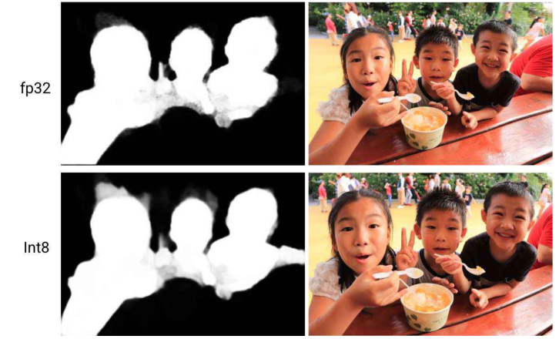
03 Ten Lessons From Three Generations
⑥ Some inference apps need floating point arithmetic
Quantization for DNNs aims to retain inference-time model quality using integers, even though all training is done in floating point.
DSAs may offer quantization, but unlike TPUv1, they should not require it.
The left image identifies the outline of objects in the right photo. The Int8 outline is fuzzy around the girl’s head and it doesn‘t isolate the arm of the person in red on the right. The unreliable outline crops the photo incorrectly.

Slide 27
03 Ten Lessons From Three Generations
The final 4 lessons are about the DNN apps themselves
⑦ Production inference normally needs multi-tenancy
⑧ DNNs grow ~1.5x/year in memory and compute
⑨ DNN workloads evolve with DNN breakthroughs
⑩ Inference SLO limit is P99 latency, not batch size

Slide 28
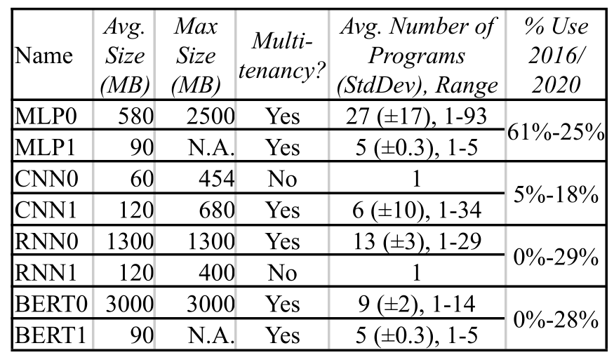
03 Ten Lessons From Three Generations
⑦ Production inference normally needs multi-tenancy
Like CPUs, DSAs should support multi-tenancy.
Sharing can lower costs and reduce latency if applications use many models.
Another reason is simply good software engineering practices.
The table shows >80% of production inference workload needs multi-tenancy.

Slide 29
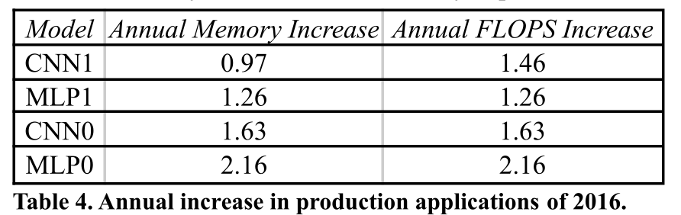
03 Ten Lessons From Three Generations
⑧ DNNs grow ~1.5x/year in memory and compute
Table 4 tracks the average annual increase in memory size and computation for the four original production inference apps that still run on TPUv1/v2/v3. At a ~1.5x annual increase, our production DNNs grow as fast as Moore’s Law, like early PC software. This rate suggests architects should provide headroom so that DSAs can remain useful over their full lifetimes.

Slide 30
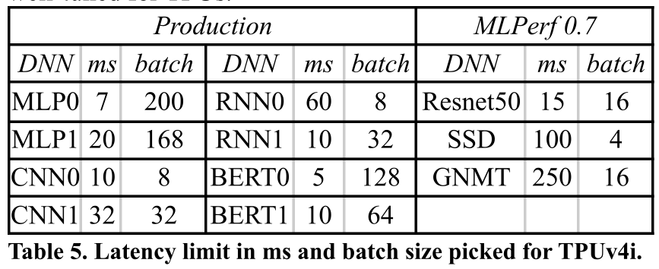
03 Ten Lessons From Three Generations
⑨ DNN workloads evolve with DNN breakthroughs
This lesson teaches the importance of programmability and flexibility for inference DSAs to track DNN progress.
⑩ Inference SLO limit is P99 latency, not batch size
Table 5 shows the P99 time SLO for production apps and the MLPerf Inference 0.5 benchmarks . It also shows the largest batch size of recent TPUs that meet the SLO. Clearly, datacenter applications limit latency, not batch size. Future DSAs should take advantage of larger batch sizes.

Slide 31
03 Ten Lessons From Three Generations
① Logic improves more quickly than wires and SRAM
TPUv4i has 4 MXUs per core vs 2 for TPUv3 and 1 for TPUv1/v2.
②Leverage existing compiler optimizations
TPUv4i evolved from TPUv3 instead of being a brand new ISA.
③Design for perf/TCO instead of perf/CapEx
TDP is low, CMEM/HBM are fast, and the die is not big.
④ Backwards ML compatibility enables rapid deployment of trained DNNs
TPUv4i supports bf16 and avoids arithmetic problems by looking like TPUv3 from the XLA compiler’s perspective.

Slide 32
03 Ten Lessons From Three Generations
⑤Inference DSAs need air cooling for global scale
Its design and 1.0 GHz clock lowers its TDP to 175W.
⑥Some inference apps need floating point arithmetic
It supports bf16 and int8, so quantization is optional.
⑦Production inference normally needs multi-tenancy
TPUv4i’s HBM capacity can support multiple tenants.

Slide 33
03 Ten Lessons From Three Generations
⑧DNNs grow ~1.5x annually in memory and compute
To support DNN growth, TPUv4i has 4 MXUs, fast on- and off-chip memory, and ICI to link 4 adjacent TPUs.
⑨DNN workloads evolve with DNN breakthroughs
Its programmability and software stack help pace DNNs.
⑩The inference SLO is P99 latency, not batch size
Backwards ML compatible training tailors DNNs to TPUv4i, yielding batch sizes of 8–128 that raise throughput andmeet SLOs. Applications do not restrict batch size.

Slide 34
TPUv4i
4
PART

Slide 35
04 TPUv4i
How the 10 Lessons Shaped TPUv4i’s Design？

Slide 36
04 TPUv4i
Compiler compatibility, not binary compatibility.
Increased on-chip SRAM storage with common memory (CMEM).
Four-dimensional tensor DMA.
Custom on-chip interconnect (OCI).
Arithmetic improvements.
Clock Rate and TDP.
ICI scaling.
Workload analysis features.

Slide 37
04 TPUv4i
About TPU
2021：Ten Lessons From Three Generations Shaped Google’s TPUv4i
2020：Google’s Training Chips Revealed: TPUv2 and TPUv3
2017：In-datacenter performance analysis of a Tensor Processing Unit.

Slide 38
博學 · 睿思 · 勤勉 · 致知
HNU
Thanks
reporter：金洁茜 S211000820

